Slide 1
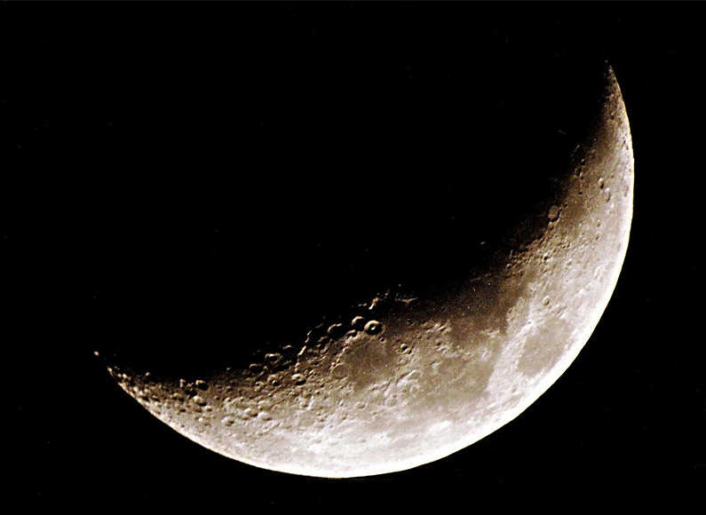
AUTOMATED CRATER DETECTION IN MOON SURFACE IMAGE
Moumita Guha Roy(Roll-99)
Swarnali Mukherjee(Roll-93)
Under the guidance of
Proff. Siddhartha Banerjee

Slide 2
CONTENTS
What is digital image processing?
Applications
Automated crater detection in moon surface satellite images
Some of the previous researches on this topic
Image segmentation
    #Image Thresholding
    #Edge Detection
    #Edge Thinning
    #Region Grow and Region Elimination
    #Final results
Future Scope of Development.

Slide 3
WHAT IS DIGITAL IMAGE PROCESSING?
An image may be defined as a two dimensional function, f (x ,y) where x, y are the spatial co-ordinates.
Digital image processing refers to processing a digital image by a digital computer.

Slide 4
APPLICATIONS
Biological Sciences
Meteorology/Satellite Imaging
Material Sciences
Medicine
Industrial inspection/Quality Control
Geology
Astronomy
Military
Physics/Chemistry
Photography

Slide 5
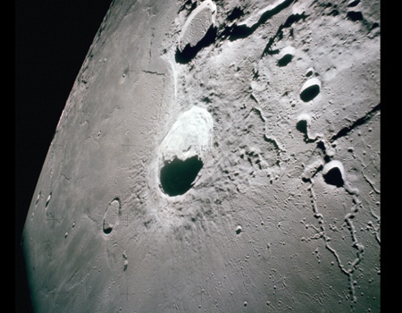
AUTOMATED CRATER DETECTION IN MOON SURFACE IMAGE
Large number of Moon surface images have been collected and it is still going on. One of the objectives is hole detection and observation of its nature.
For geologic and planetary sciences, holes are very important because they might hold many clues.
Generally, attributes and locations of holes are achieved from Moon surface image through image analysis
Moon surface image

Slide 6
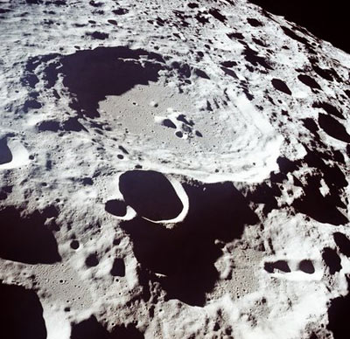
The essential prerequisite for this task is the hole segmentation.
Currently, hole segmentation of Moon imagery is mostly accomplished by manual labeling but it is extreme time consuming.
Therefore the need for automated hole detection arises.

Slide 7
PREVIOUS RESEARCHES
It is built up from a boosting algorithm whose simplicity combined with an original learning strategy leads to a fast and robust process with consistent results.
The approach is validated with image data sets from Moon surface captured by the Moon Orbiter Camera.

Slide 8
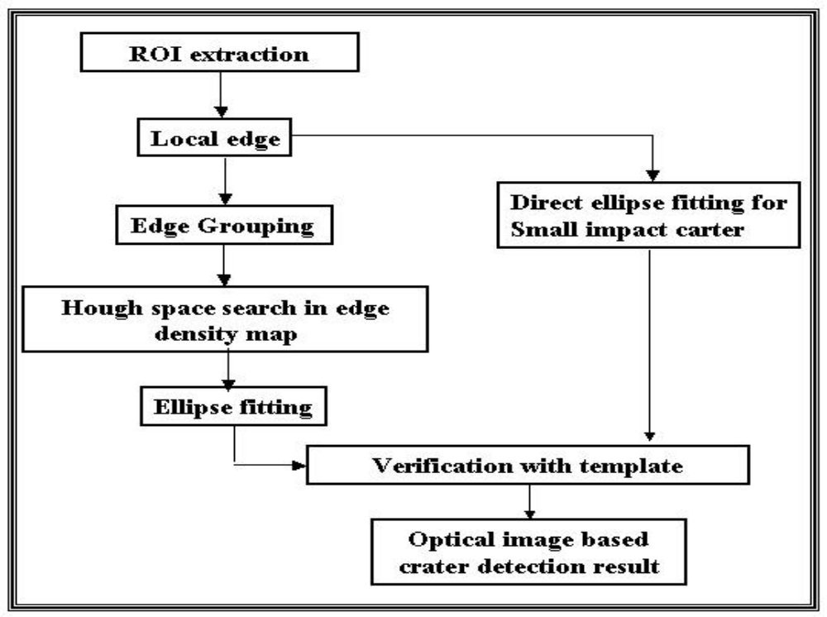
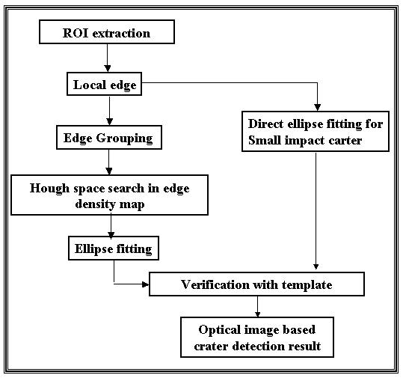
ANOTHER APPROACH

Slide 9
IMAGE SEGMENTATION
Segmentation subdivides an image into its constituent regions or objects.
Image segmentation is typically used to locate objects and boundaries

Slide 10
INTENSITY BASED THRESHOLDING
Image Thresholding classifies pixels into two categories:
1)Those to which some property measured from the image falls below a threshold, and
2)those at which the property equals or exceeds a threshold.
It creates a binary image of the given image.

Slide 11
GLOBAL THRESHOLDING
In fixed (or global) Thresholding, the threshold value is held constant throughout the image:
g (x ,y) = 0 if f (x ,y)<T
g (x, y) = 1 if f (x ,y)>=T

Slide 12
ITERATIVE OPTIMAL THRESHOLD SELECTION
1. Select an initial estimate for T (usually average intensity)
2. Segment the image using T. This produces 2 groups: G1 pixels with intensity value >T and G2 , with intensity values <=T
3. Compute the average intensity values μ1 and μ2, for the pixels in G1 and G2 respectively.
4. New threshold: T=1/2(μ1+μ2)
5. Repeat steps 2 to 4 until T stabilizes.

Slide 13
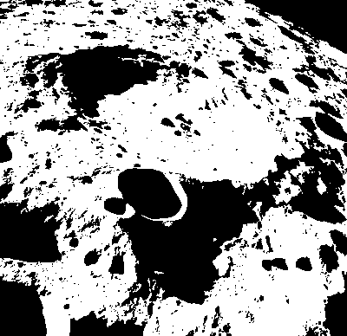
Original image of moon surface
The above image after Thresholding

Slide 14
DETECTION OF EDGES
There are mainly three kinds of operator which are generally used to detect edges of an image. Those are:
i) Robert edge detection
ii) Prewitt edge detection
iii) Sobel edge detection

Slide 15
PREWITT EDGE DETECTION
g_{x}= (z₇+z₈+z₉)-(z₁+z₂+z₃)
g_{y}= (z₃+z₆+z₉)-(z₁+z₄+z₇)
z₁ | z₂ | z₃
z₄ | z₅ | z₆
z₇ | z₈ | z₉

Slide 16
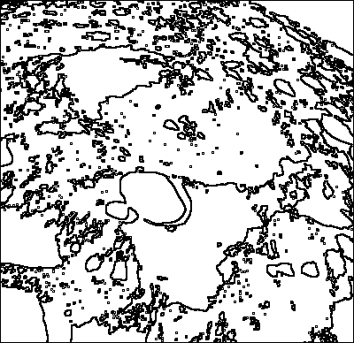
Thresholded Image
Image after Edge Detection

Slide 17
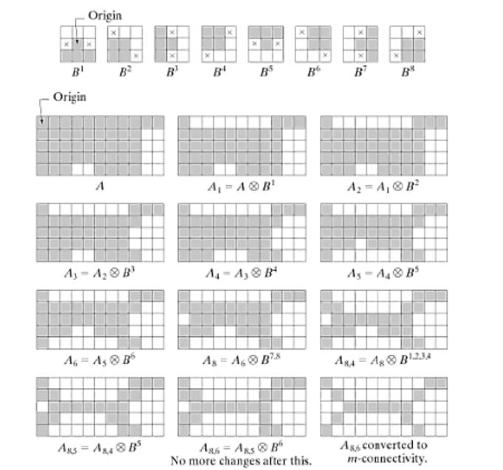
EDGE THINNING

Slide 18
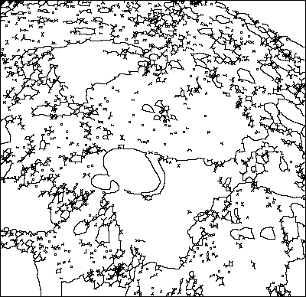
Edge Detected image
Image after Edge Thinning

Slide 19
REGION GROWING
Region Growing is a procedure that groups pixels based on predefined criteria for growth.
We have to start with a “seed point” and from this, regions are grown.
The neighboring pixels of initial “seed point” are checked and determines whether the neighbor pixels should be added to the region.

Slide 20
ALGORITHM
DIVIDING THE IMAGE INTO SEVERAL REGIONS:
1. An initial label value is chosen.
2. An arbitrary white pixel is chosen.
3. The predefined initial label value is assigned to that pixel.
4. The 4-neighbour of that pixel is considered.
5. If any of the 4-neighbour contains a white pixel the predefined value is assigned to those pixel
6. If any of the 4-neighbour contains a black pixel the label value is incremented, assigned to that pixel and step 4 and step 5 is repeated.
7. The process is repeated until there are no more white pixels.

Slide 21
CONTINUED..
ELIMINATING REGIONS WHICH HAVE FEWER PIXEL COUNTS
From the result obtained using the above algorithm count the number of pixels with a given label.
If this exceeds a predefined constant which in our case is 50 that region is considered to be an actual crater otherwise it is neglected.

Slide 22
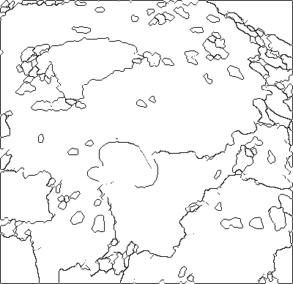
Image with Thinned edges
Image after Region grow and Region Elimination

Slide 23
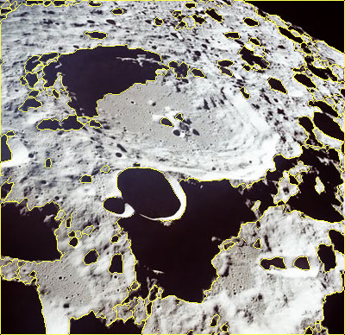
Final Result

Slide 24
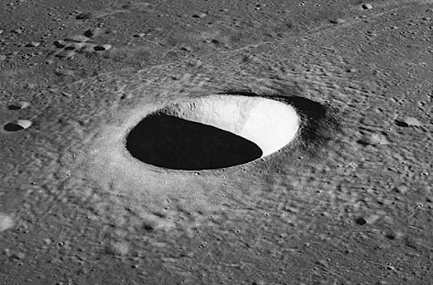
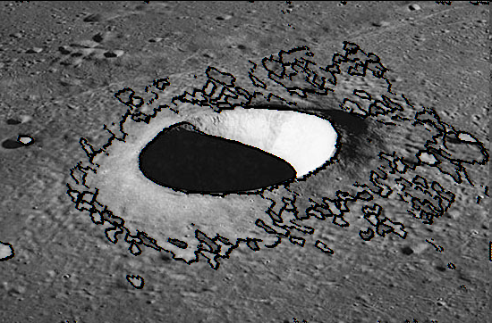
Input Image
Output Image

Slide 25
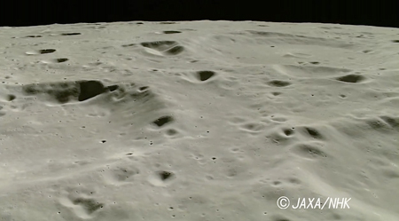
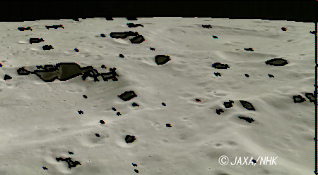
Input Image
Output Image

Slide 26
FUTURE SCOPE OF DEVELOPMENT
We have implemented the algorithm for .bmp images. It can also be implemented for .jpeg images also.
We have considered the craters only.
Shadow detection algorithm can be implemented.

Slide 27
SHADOW DETECTION AND ELIMINATION
Each region whose average intensity is black is considered.
Shadows are not circular in shape.
The horizontal length is greater than the vertical length.
If the horizontal length is greater than the vertical length of that region it is a shadow and hence eliminated.

Slide 28
ALGORITHM
  For each region consider only those regions whose average intensity is in the range of 245 and 255.( hence it is a black region )
  Find out the left most pixel of that region.
  For each black pixels which is in the 4-neighbor of the left most pixel calculate the Euclidean distance between each of the pair of black pixels.
  Take the maximum of these distances and record it to be the highest vertical length of that region

Slide 29
CONTINUED..
  Similarly find out the top most pixel of that region
  For each black pixels which is in the 4-neighbour of the top most pixel calculate the Euclidean distance between each of the pair of black pixels.
  Take the maximum of these distances and record it to be maximum horizontal length of that region.
  If the vertical distance is less than the horizontal distance that region is not a shadow and hence a crater.

Slide 30
CONCLUSION
This algorithm almost correctly identifies the craters in the image. However, the testing set is extremely small
By noticing the images we conclude the distinguishable feature of the shadows and craters. For any other images this conclusion may be wrong.

Slide 31
BIBLIOGRAPHY
Digital Image processing- Rafel C.. Gonzalez
,Richard E. Woods.
http://articles.cnn.com/2010-01-01/tech/moon.lava.hole_1_lunar-base-lava-flows-lunar-surface?_s=PM:TECH
http://en.wikipedia.org/wiki/RGB_color_model
http://en.wikipedia.org/wiki/Thresholding_(image_processing)
http://www.owlnet.rice.edu/~elec539/Projects97/morphjrks/moredge.html
http://homepages.inf.ed.ac.uk/rbf/HIPR2/thin.htm
http://homepages.inf.ed.ac.uk/rbf/HIPR2/open.htm

Slide 32
THANK YOU

Slide 33
QUESTIONS?

